Slide 1
Nibble – Your AI-Powered Recipe Preparation Assistant
CAPSTONE PROJECT
Presented By:
1. Swarnabha Biswas- Narula Institute of Technology Information Technology

Slide 2
OUTLINE
Problem Statement
Proposed Solution
System Development Approach
Algorithm & Deployment
Results
Conclusion
Future Scope
References

Slide 3
Problem Statement
Example: Problem Statement No. 16- Recipe Preparation Agent
The Challenge - A Recipe Preparation Agent helps users cook meals using only the ingredients they have
on hand.
By inputting available groceries, users receive tailored recipe suggestions using a RAG-based AI system.
The agent retrieves relevant recipes and generates step-by-step instructions adapted to ingredient
limitations.
It offers substitutions, cooking tips, and dietary adjustments based on user preferences or restrictions.
Designed to reduce food waste and save time, it turns pantry items into practical meal solutions.
This AI assistant makes everyday cooking smarter, simpler, and more sustainable.
Technology - Use of IBM cloud lite services /IBM Granity is mandatory.

Slide 4
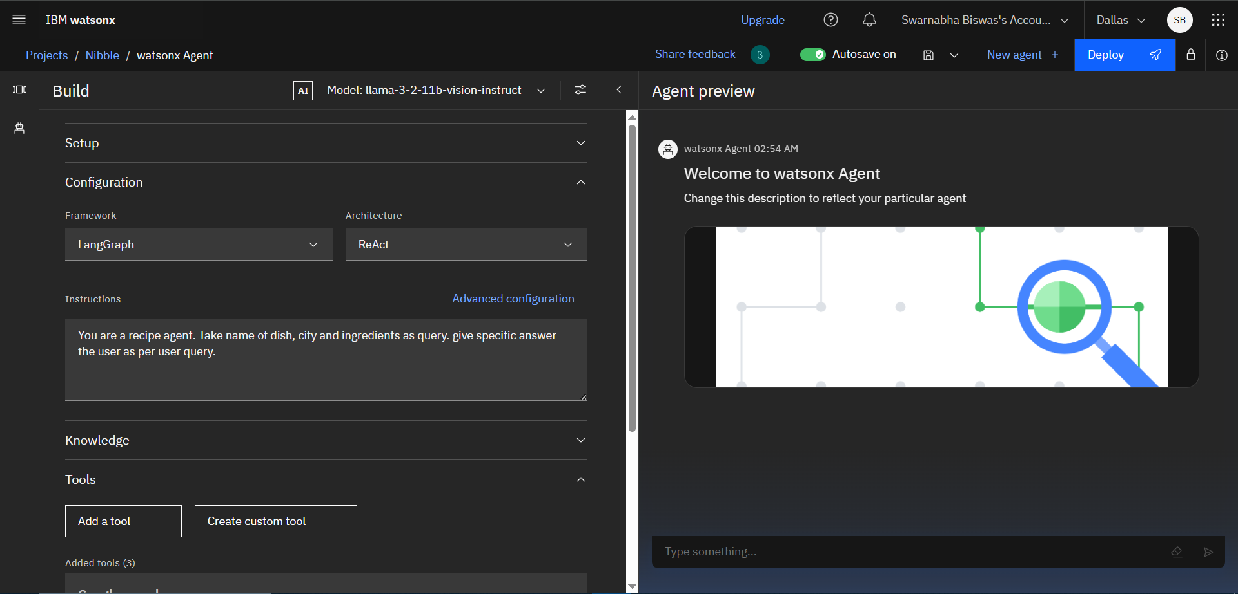
Proposed Solution
Nibble – An AI-powered Recipe Preparation Assistant that helps users:
Get ingredient lists and substitutions
Follow recipes step-by-step
Set and manage cooking timers
Ask natural language questions like:
“What can I use instead of sour cream?”
“How long should I boil potatoes?”
“Show me step 3 again.”

Slide 5
System Approach
Platform: Platform: IBM Watson Assistant + Agent Frameworks
Data: Recipes, cuisines, meals and countries

Slide 6
Algorithm & Deployment
Conversation-driven , Agent logic handles:
Recipe Initialization → ask meal type (e.g., “Pasta”, “Curry”)
Ingredient Validation → check what user has.
Stepwise Cooking Guidance → interactive instructions

Slide 7
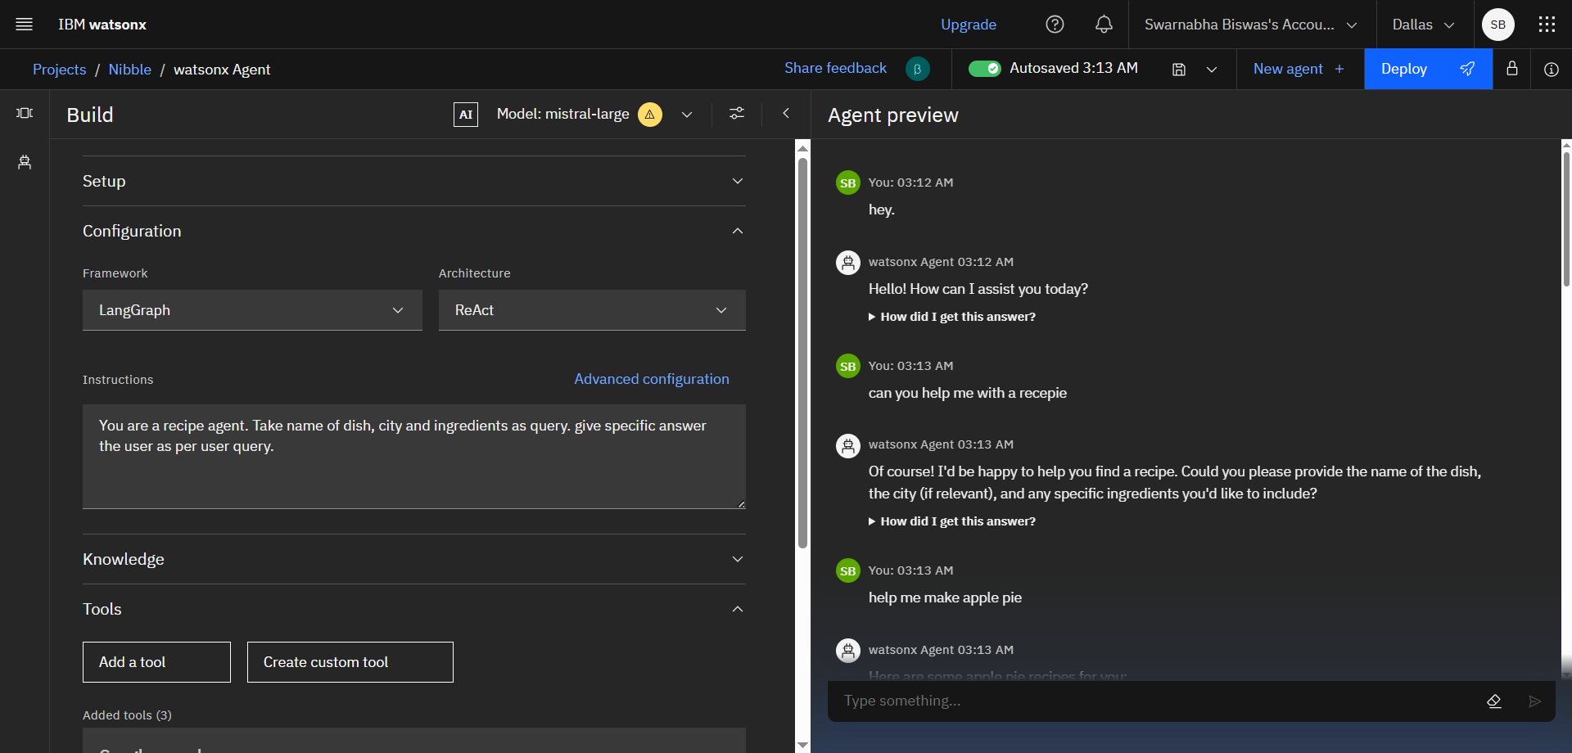
Result
Users can interact as follows:
“Start Chicken Curry recipe.” “I don’t have garam masala — what else can I use?”
Bot responds intelligently and contextually
Simplifies complex multi-step cooking

Slide 8
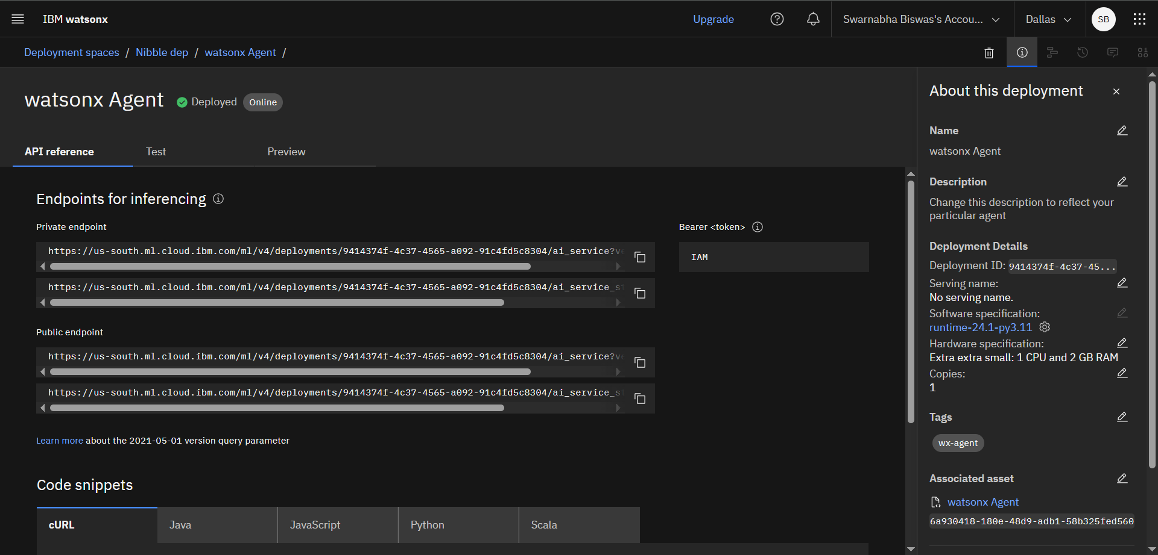
API’s

Slide 9
Conclusion
Nibble transforms the home-cooking experience by:
Making recipes more interactive and accessible
Offering dynamic help, not just static instructions
Reducing kitchen mistakes due to confusion
Empowering beginners and multitaskers alike
It bridges the gap between cookbooks and intelligent real-time assistance.

Slide 10
Future scope
Add voice-only cooking mode (Alexa-style)
Integrate with smart kitchen devices (ovens, timers)
Expand to dietary filters (vegan, keto, gluten-free)
Track pantry items or recommend based on ingredients
Multi-language support for regional Indian users
Save user preferences or last used recipes

Slide 11
References
IBM Watson Assistant documentation
IBM Cloud services
College admission policies (sample docs)

Slide 12
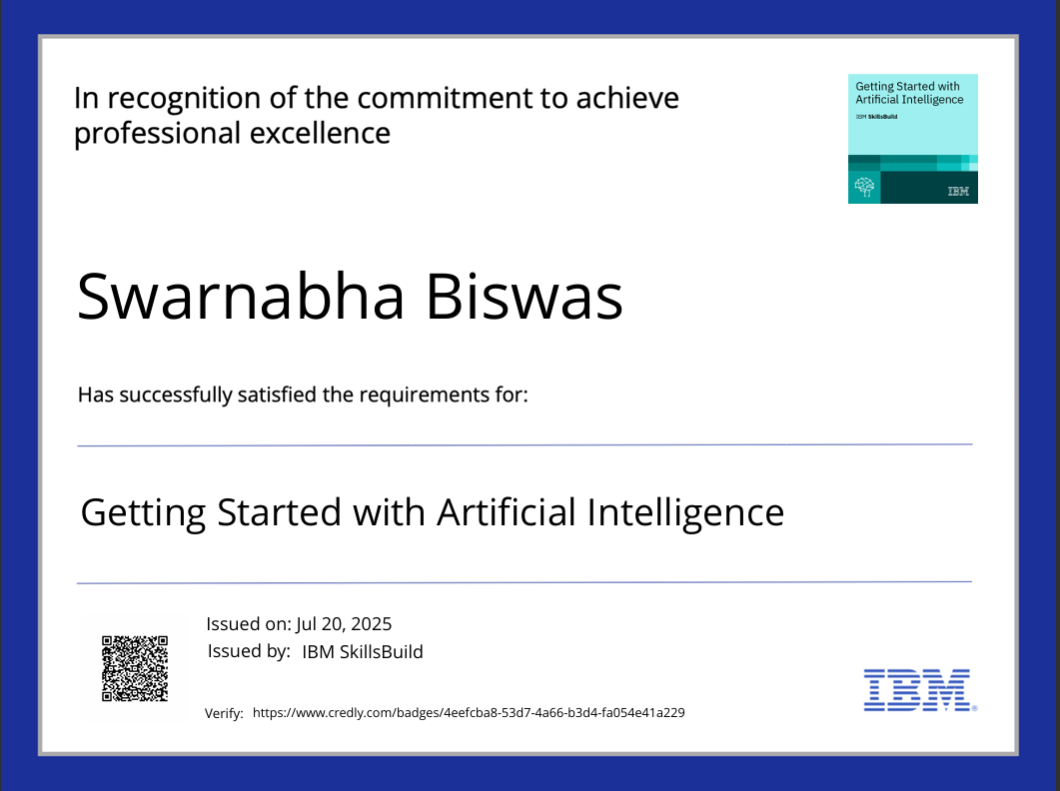
IBM Certifications

Slide 13
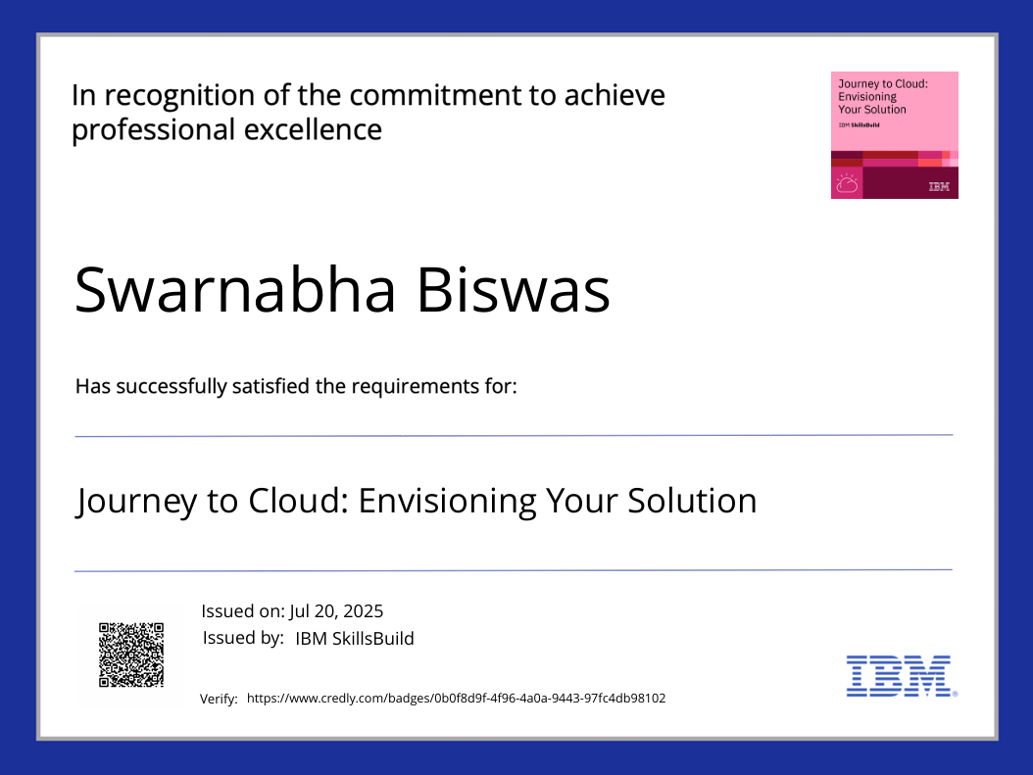
IBM Certifications

Slide 14
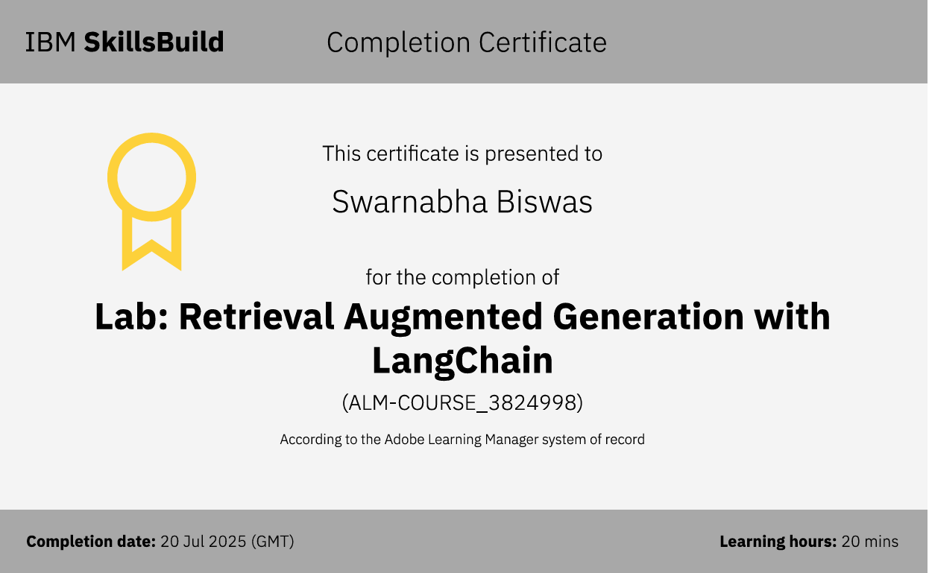
IBM Certifications

Slide 15
THANK YOU

